Slide 1
RATETOUILLE
By Archit Jain

Slide 2
What it does?
Ratetouille comes in two versions:
A Web Page,
An Android Application.
The aim of the application is to
Help users enhance their reviewing experience.
Help customers find exquisite delicacies around them.
Bring information to the user in an extraordinary way as never seen before.

Slide 3
Motivation
Thousands of people are sharing their experiences on rating portals everyday.
Less than 36% of ratings are converted to reviews.
Reviews hold the actual expression of the experience.
Reading through thousands of reviews to analyse the sentiment can be both confusing and tiresome for the user.

Slide 4

Problem Definition
Traditional rating for restaurants was done by experts and it did not involve the common people.
With the modernising lifestyle, customers prefer making an informed choice.
To buttress those choices, the challenge of collecting the reviews and presenting it to the user in an accessible manner is deemed critical.

Slide 5
Key Issues Addressed
Only insights of professionals, not the common public in the traditional system.
Dynamic approach.
Provide information about various restaurants near a location.
Insightful rating.

Slide 6
Other Alternative Apps
Apps like Zomato, Yelp, etc. have been created to provide review information to the customers.
The approach adopted involves collecting & displaying only numerical ratings. Thus, providing partial information.
Reviews are generally sorted with respect to the highest relevance of a restaurant.
Hence, the reviews seen by the user might be biased towards a particular sentiment and also provide only partial information.
Notes:
Related work and their limitation slide
Talk about how 5 star system only deals with aggregation of reviews

Slide 7
Our Approach
Using Information Retrieval(IR) System to extract hidden sentiments.
Sentiments collected are further aggregated to present a scoring system based on a 5 star rating scale.
The user can easily make an informed decision based on the ratings used across the application.
Notes:
Ways of resolving the Key Issues and the barrier in Alternative apps.

Slide 8
Core Algorithm
Read all the reviews for a particular restaurant.
Preprocess the reviews.
For each review, map the words present in the algorithm to the pre-existing list of positive, negative and neutral words.
Assign the scores to the selected words in the review and calculate the total score. Score is dependent on the rarity of the words within the reviews.
Add up all the scores over the restaurant to get a net score for the restaurant.
Map it on the 5 star rating scale.

Slide 9
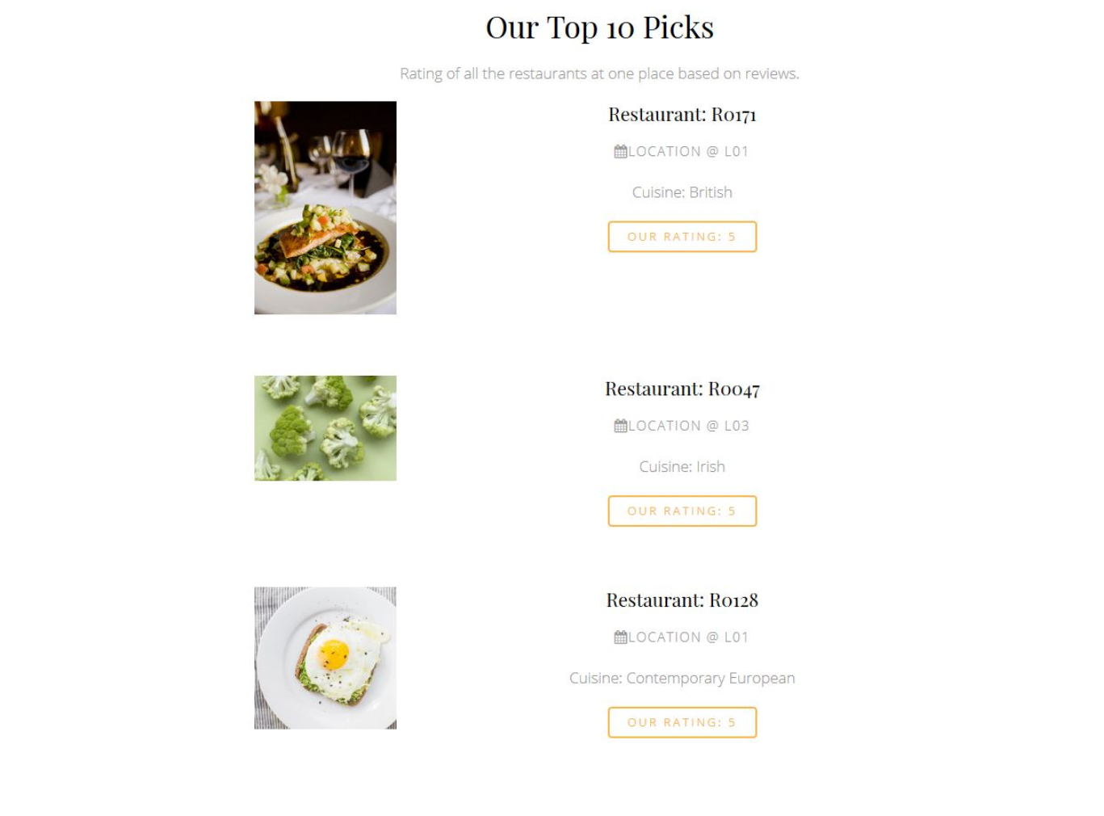
Place your screenshot here
Website
The website provides the user with a simple interface showcasing the important details of the restaurants and their ratings.

Slide 10
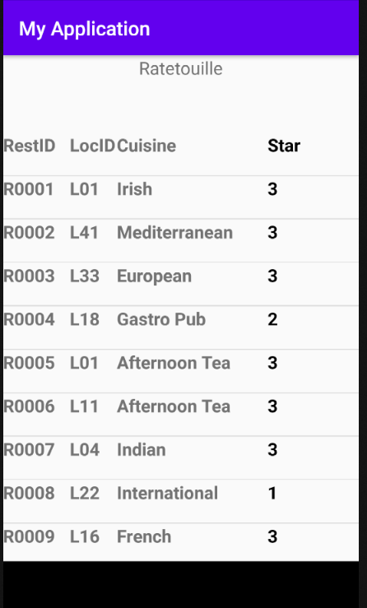
Place your screenshot here
Android Project
A simple android application showcasing the details of the restaurants in a singular list view.

Slide 11
Validation
Restaurant ID | Reviews
R0001 | A great place for Irish music great bar and full of great people After the Irish band more modern music on a must go
R0001 | Absolutely exceptional food and staff were very friendly and helpful Lovely atmosphere will definitely be back
R0001 | Cant remember pizza better than this anywhere in Dublin Gorgeous really authentic italian food Great prices too
R0001 | Poor poor poor I ordered the breakfast It arrived 30 mins later Wrong order I asked for friends eggs The staff were rude and made it seem like I was a hindrance to them
R0001 | Very bad service rude staff members Wasnt happy with the way I was treated
Review 3 - Cant remember pizza better than this anywhere in Dublin Gorgeous really authentic italian food Decent prices too
Word - Negative
Word - Positive
Word - Neutral
Notes:
Explain Inverse Term Frequency to find assign higher score to rearer terms.

Slide 12
Conclusion
With the motive to make use of technology efficiently and to make information accessible and easily understandable for the users, Ratetouille analyses the true expressions of all the users for the restaurants and present it to the user in a traditional format.
Notes:
Mention key contributions

Slide 13
Future Work
Provide in-depth ratings based on food, ambience and services.
Implementing Bi-gram and N-gram for contextual classification.
Use Machine Learning Classification Algorithms to predict better scores for the reviews.
The Application and Website will hold a series of sorted reviews based on the score so as to express the validation to the users too.

Slide 14
THANK YOU!

Slide 15
ANY QUESTIONS?

